Slide 1
Heuristic Search Techniques

Slide 2
Heuristic Search
Are a set of general purpose search techniques.
Can be described independently of any problem domain.
Their efficacy is highly dependent on the applied problem domain since they are unable to overcome combinatorial explosion.
Two methods already discussed (DFS and BFS).

Slide 3
Generate and Test
Algorithm: Generate and Test
Generate a possible solution. For some problems, this means generating a particular point on problem space. For others, it means generating a path from start state.
Test to see if it is actually a solution by comparing the chosen point or end point of chosen path to the set of acceptable states.
If solution has been found quit. Otherwise return to step 1.
Is a DFS procedure.

Slide 4
Example: Colored Blocks Problem
Four six sided cubes each side of the cube painted one of the four colors.
Task: arrangement of the cubes in a row such that on all four sides of the row one block face of each color is showing.
Solution: There are more, say, red faces than there are any colors. While placing a block with red faces use as few of them as outside faces.

Slide 5
Hill climbing
In pure generate and test procedure, the test function responds only with yes or no.
Hill climbing is a variant of generate and test in which the feedback from the test procedure decides the direction of search process.
Test function is augmented with a heuristic function to provide an estimate of how close a given state is to the goal state.

Slide 6
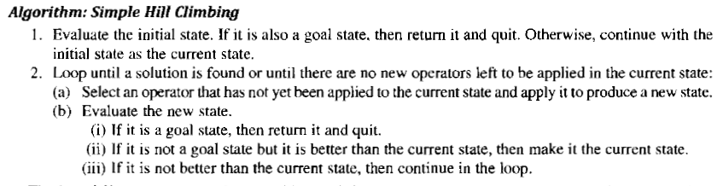
Simple Hill Climbing

Slide 7
Colored Blocks Problem Revisited
Heuristic function: Sum of the number of different colors on each of four sides ( value 16 in this case).
Rule: Pick up a block and rotate it 90 degree in any direction.
Application of hill climbing: Generate a new state by selecting a block and rotating it. If the resulting state is better, keep it. If not return to the previous state an try a different combination.

Slide 8
Best First Search
DFS is good because it allows solution to be found without all competing branches having to be expanded.
BFS is good because it does not get trapped in dead end paths.
BFS combines the effectiveness of both by following a single path at a time but switching paths when some competing path looks more promising than the current one.

Slide 9
How does it work?
At each step of the search process the most promising node is selected by applying an appropriate heuristic.
The node is then expanded using appropriate set of rules.
If it is the solution then the search process stops.
Otherwise all the new nodes are added to the set of nodes generated so far.
Again the most promising node is selected and the process continues.

Slide 10
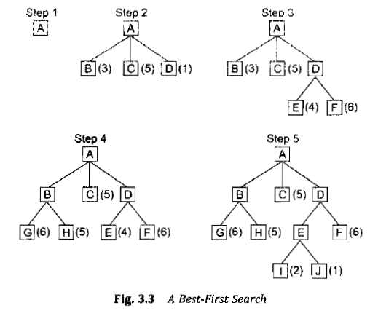
Example

Slide 11
The heuristic function is an estimate of the cost of getting to the solution from a given node.
BFS is applied on a directed graph in which each node represents a point in problem space. Each node contains a description of the problem state, an indication how promising it is, list of nodes generated from it and the parent link.
Such a graph is called an OR graph, since each branch represents an alternate problem solving path.

Slide 12
Two list of nodes are required....
OPEN: nodes that have been generated and have had the heuristic function applied on them but have not yet been examined(i.e. their successors generated).
CLOSED: nodes that have been examined.

Slide 13
Heuristic Function….
Estimates the merit of each node generated.
Indicated as f1.
Defined as the sum of two functions g and h1.
g is a measure of the cost of getting from initial state to current state.
H1 is the estimate of the cost of getting from the current node to the goal state.

Slide 14
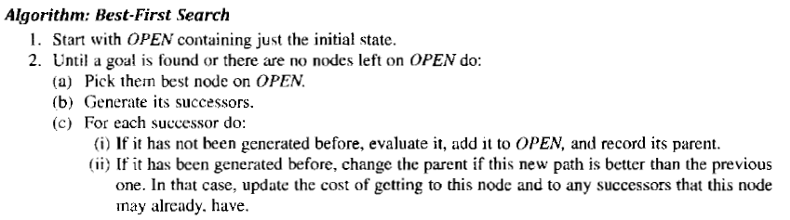

Slide 15
Constraint Satisfaction
Goal is to discover some problem state that satisfies a given set of constraints.
Ex: Cryptarithmetic puzzles.
Is a search procedure that operates in a space of constraint sets.
Initial state: problem description.
Goal state: problem solved following constraints.
Two step process.

Slide 16
First, constraints are discovered and propagated as far as possible throughout the system.
Second, if the solution is not yet found a guess is made and added as a new constraint.
Constraint propagation terminates for one of the two reasons. First, a contradiction is detected. Second, propagation has run out of steam and no further changes can be made on the basis of current knowledge.

Slide 17
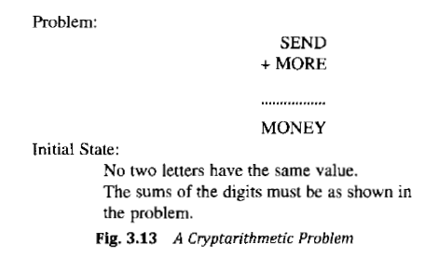

Slide 18
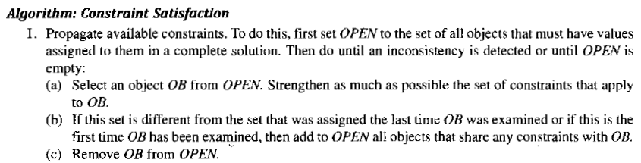

Slide 19
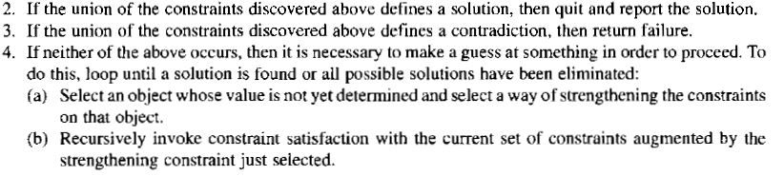

Slide 20
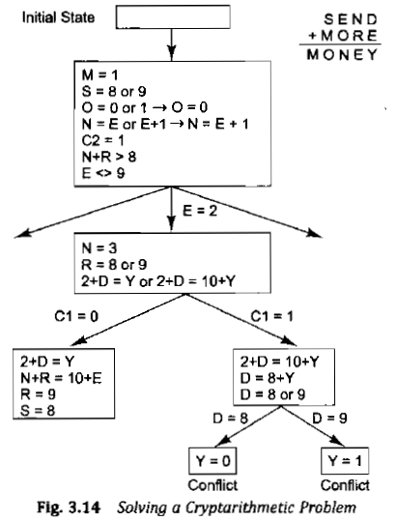

Slide 21
Means End Analysis
Previous algorithms used either forward or backward reasoning.
MEA uses a mixture of these two techniques.
Major parts of the problem are solved first and then these parts appended to get the solution.
Difference between current state and goal state is to be detected.

Slide 22
Operator to be applied to reduce this difference.
But this operator may not be applicable to the current state.
This kind of backward chaining in which operators are selected and then sub goals are set up to establish the preconditions of the operators are called operator sub goaling.
If the operator does not produce the goal state we want then the same process is applicable.
Thus the process can be applied recursively.

Slide 23
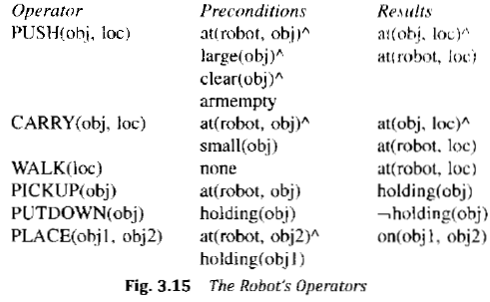

Slide 24
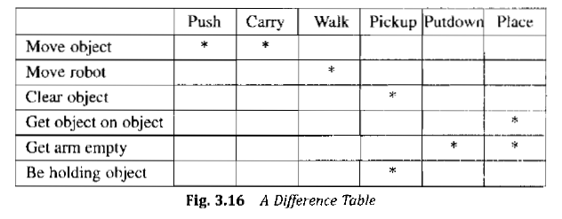

Slide 25
Ex: Moving a desk with two things on it.
Push or Carry operators may be used.
Preconditions not satisfied for carry(as object is not small).
Preconditions for push satisfied.

Slide 26
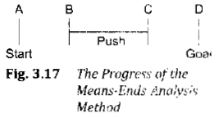
Ex: Moving a desk with two things on it.
Push or Carry operators may be used.
Preconditions not satisfied for carry(as object is not small).
2nd and 4th preconditions for push satisfied.
For 3rd and 4th preconditions to be satisfied pickup and putdown operators are required.

Slide 27
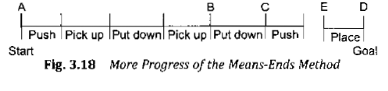

Slide 28
